Slide 1


Analysis of
U.S. Cocaine & Fentanyl
Overdoses
Dorina Jordan
Capstone Project

Slide 2


Project Overview
Key objectives:
Technologies Used:
Data Sources:
What were the impacts of hospitalizations due overdose?
Which age and sex demographics were most affected by overdoses?
Is there a certain time of year or season in which overdoses occur?
Python
Excel
CDC - DOSE Dashboard: Nonfatal Overdose Emergency Department and Inpatient Hospitalization Discharge Data
35 states share level patient data. 32 states sharing both in-patent and emergency dept. data. 3 states only sharing in-patient data.
2018 - 2021 fentanyl data totaling 2,413 records have been suppressed or not provided due to HIPPA laws.
National Center for Health Statistics
National Institute on Drug Abuse
Time Frame:
2018 - 2023
Page 2

Slide 3
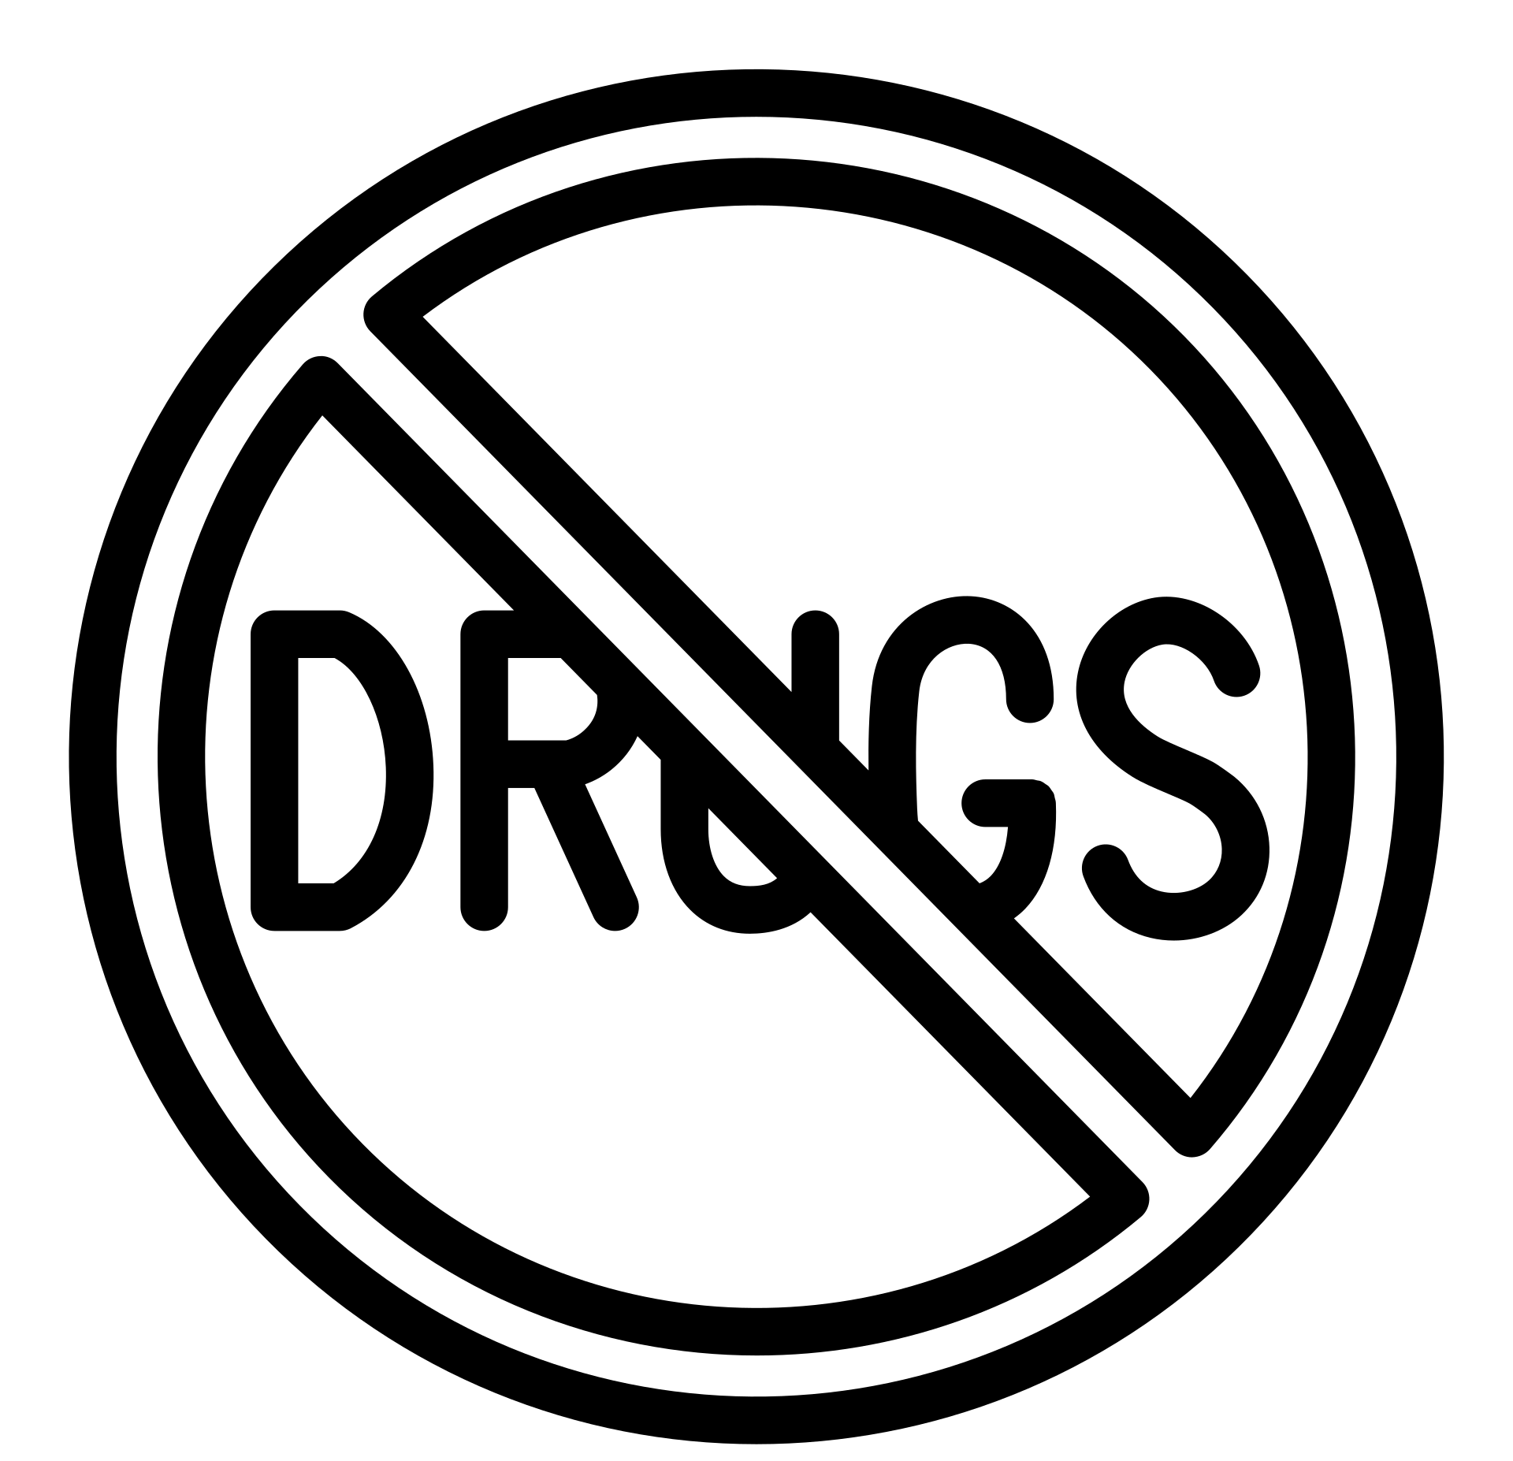


Inspiration
On November 14, 2023, my younger brother Darnell died of an cocaine and fentanyl overdose. He was only 32 years old. His addiction was brought on by a near-fatal car crash that led to the use of these drugs to cope with the pain.
To date of this analysis there were a reported 1,312,670 deaths from cocaine and fentanyl overdose in the US from 2018 - 2023.
Page 3

Slide 4

What is Cocaine & Fentanyl?
Fentanyl is an opioid drug, like morphine or heroin. It is made entirely in laboratories, with no natural ingredients.
Cocaine is an addictive stimulant drug made from the leaves of the coca plant (Erythroxylon coca) which is native to South America.
An approved prescription pain medicine, more powerful than many other opioids. Often combined with cocaine to induce a stronger high, even a small amount can cause overdose.
Can be snorted in the nose, rubbed in the gums, injected into the skin and smoked.
Most used by 19.1% restaurant workers, 14% of the Arts and Entertainment professionals, and 36% of doctors and health professionals within a given 30-day period
— National Institute on Drug Abuse
Page 4

Slide 5

What impacts does overdose have on hospitalizations ?
Page 5

Slide 6
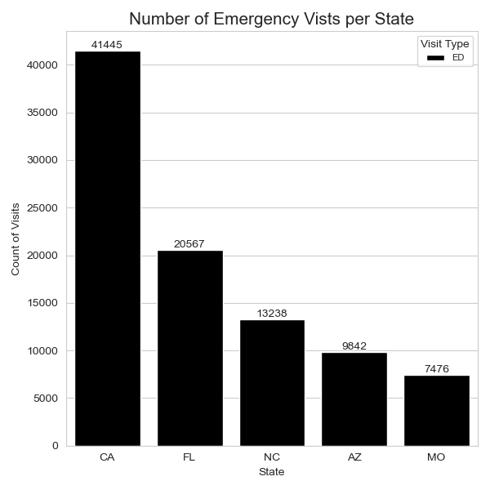
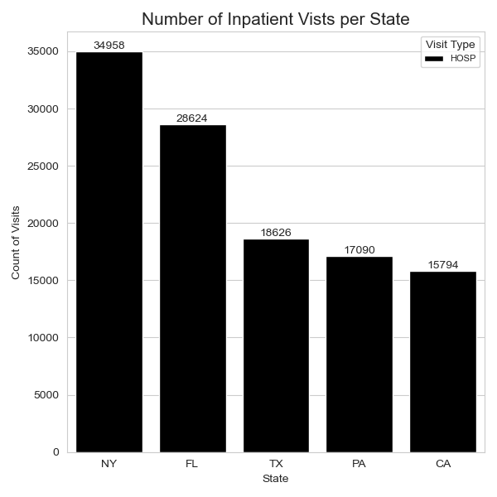

Cocaine Nonfatal Hospitalizations Per State
California had 41,445 emergency department visits, the most of all states.
74.4% of all cocaine overdoses result in inpatient hospitalizations. (105, 299)
New York had 34,958 inpatient hospitalizations, the most of all states.
Page 6

Slide 7
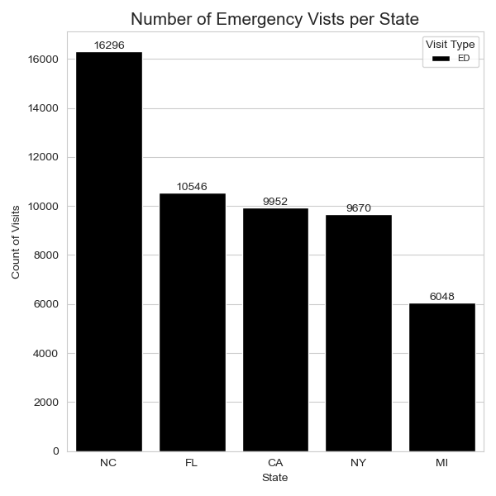
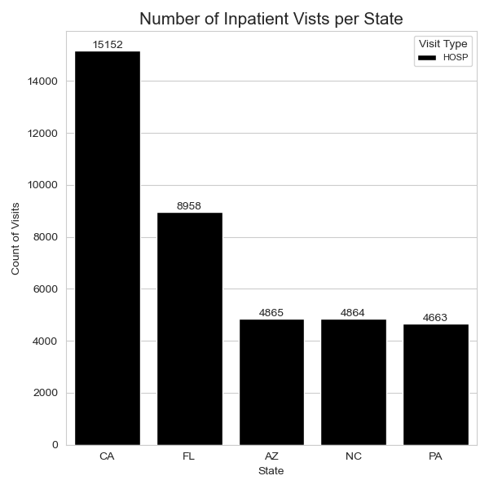
Fentanyl Nonfatal Hospitalizations Per State
North Carolina had 16,296 emergency departments visits, the most of all states.
62.3% of fentanyl overdoses result in emergency department visits. (74,435)
California had 15,152 inpatient hospitalizations, the most of all states.
Page 7

Slide 8

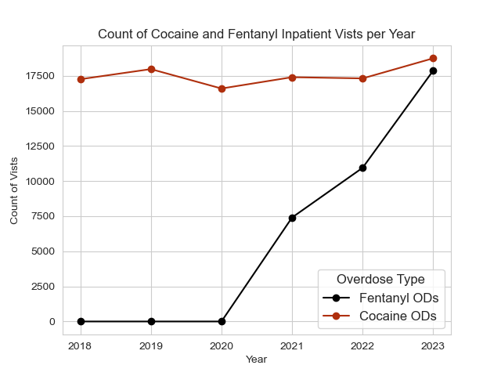
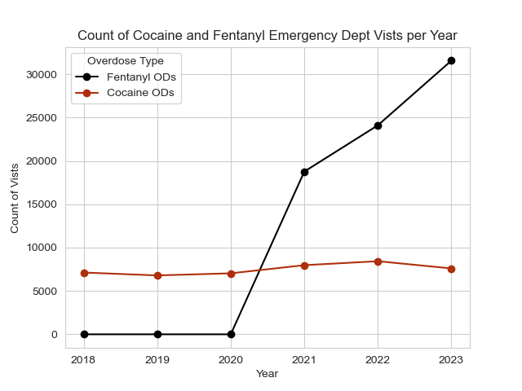
Inpatient & Emergency Dept Visits per Year
Over time fentanyl inpatient visits increased by 3,000 to 7,000 increments within a 3 year period.
Cocaine remained consistent at approx. 17,000 on average with a spike in 2023 to 18,749 visits
Incline in amount of emergency dept. visits at 18,766 in 2021, increasing by 5,000 to 7,000 increments year over year.
Cocaine remained consistent at approx. 7,000 on average with a spike in 2022 to about 8,000 on average
Page 8

Slide 9

States most affected by cocaine overdoses
state | cocaine percentage | Population affected
North Carolina | 0.0233 | 246,379
Washington DC | 0.0200 | 13,674
New York | 0.0200 | 394,036
Lousiana | 0.0150 | 69,408
Florida | 0.0150 | 327,563
Highest % of overdoses occurred in North Carolina and Washington DC between 2018 - 2023 presenting a cocaine issue.
North Carolina average population 10,574,185 and Washington DC average population 683,699.
Page 9
25 state level patient data has been suppressed or not provided due to HIPPA laws

Slide 10

States most affected by fentanyl overdoses
state | fentanyl percentage | Population affected
Oregon | 0.0183 | 77,390
Rhode Island | 0.0183 | 19,827
Arizona | 0.0167 | 121,665
Missouri | 0.0150 | 92,411
North Carolina | 0.0133 | 140,636
Highest % of overdoses occurred in Oregon and Rhode Island between 2018 - 2023 presenting fentanyl problem.
Oregon average population 4,228,983 and Rhode Island average population 1,083,472.
Page 10
25 state level patient data has been suppressed or not provided due to HIPPA laws

Slide 11
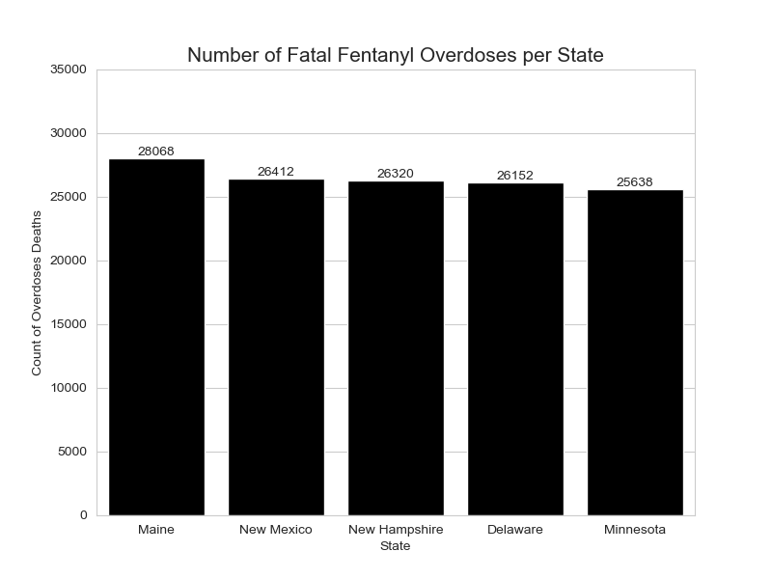
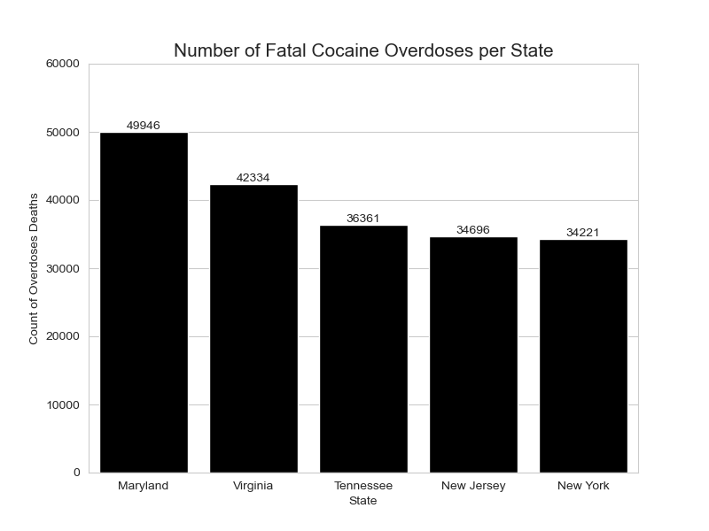
Fatal Overdose per State
Maine experienced most fentanyl overdose deaths at 28,068, with a population of approx. 1.37 million. 0.021% of total overdose deaths.
Maryland experienced most cocaine overdose deaths at 49,946, with a population of approx. 6.13 million, nearly double those of fentanyl. 0.038% of total overdose deaths.
Page 11

Slide 12
Which age and sex demographics were most affected by overdoses?
Page 12

Slide 13
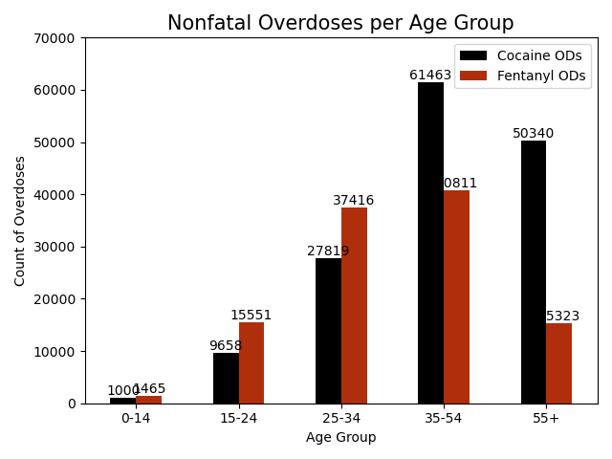
Nonfatal overdoses by
age group
35 - 54 group most affected by both forms of overdoses. 61,463 cocaine and 40,811 fentanyl. 39% of total overdoses.
55+ group were most affected by cocaine overdoses than fentanyl at 50,340. 19% of total overdoses.
Groups under age 34 suffered the most fentanyl overdoses. Representing 58.6% of total overdoses for people under the age of 34.
Page 13

Slide 14

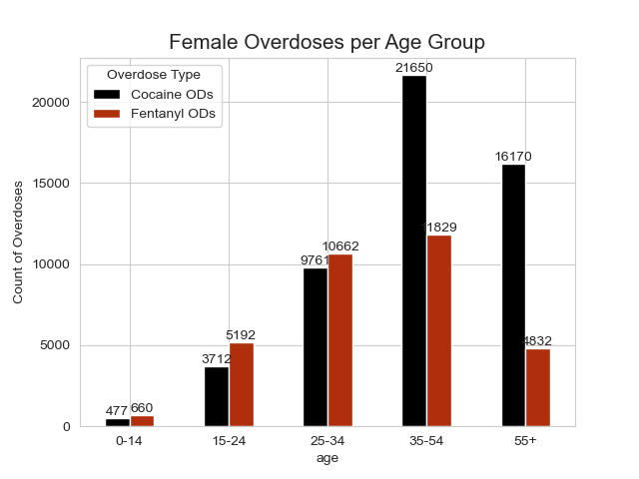
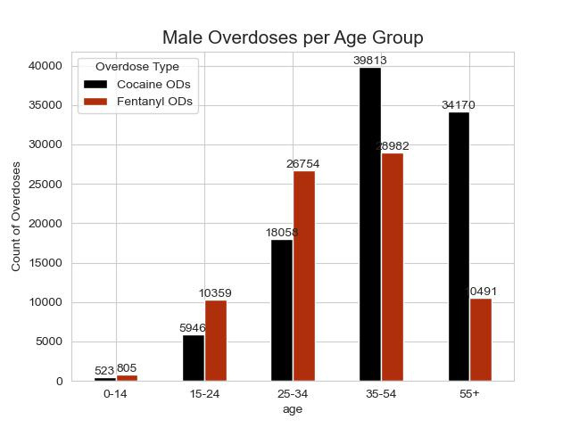
Overdose by Sex
Females aged 35 - 54 have most affected by overdoses at 39.4%.
On average, 77% of all overdoses suffered by 55+ aged females were cocaine related.
Men are disproportionately affected by overdoses in both categories, doubling those of women. Experiencing 90,956 more overdoses than women at 52% more on average.
39% of overdoses suffered by males were aged 35 - 54
Page 14

Slide 15
Is there a certain time of year or season in which overdoses occur?
Page 15

Slide 16

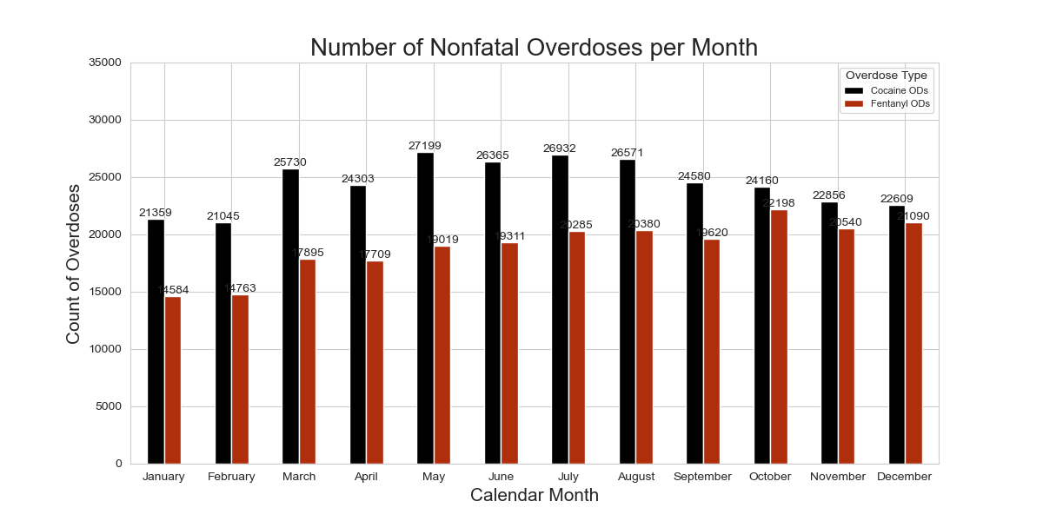

Nonfatal Overdoses Per Month
Most cocaine overdoses occur during the warmer months or the spring/summer seasons; data suggesting this drug is abuse when an individual is with a group or in a party scene. (May - August)
Most fentanyl overdoses occur during the colder months or the fall/winter seasons; data suggesting this drug is usually abused when one is indoors and most likely during the holiday season. (October - December)
Page 16

Slide 17
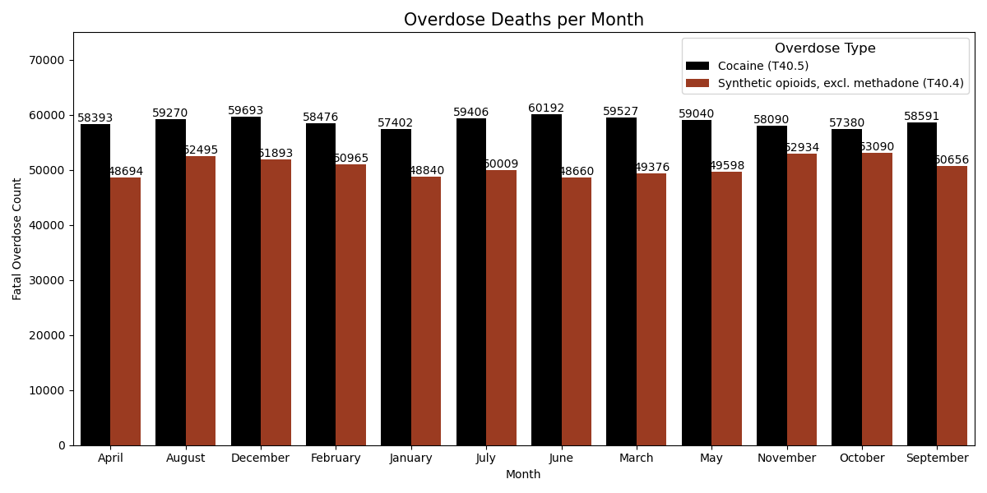
Overdose Deaths per Month
Highest number of cocaine induced deaths occurred in June. (60,192)
Highest number of fentanyl induced deaths occurred in October and November with an average of 53,000.
Page 17

Slide 18
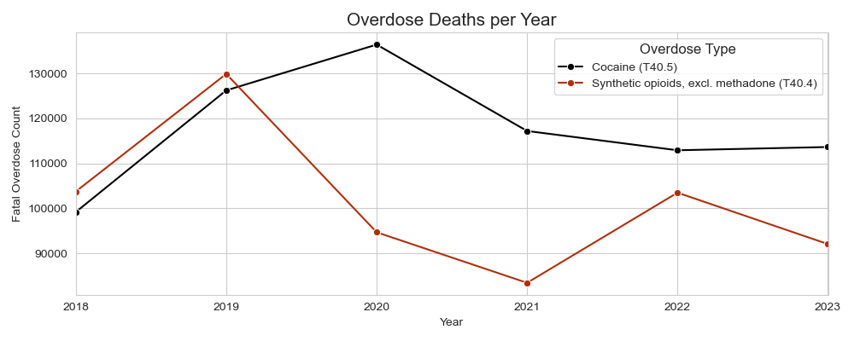
Overdose Deaths per Year
2020 most cocaine induced deaths with 136,386. 10.39% of total overdose deaths.
2019 most fentanyl induced deaths with 129,871. 9.9% of total overdose deaths.
2021 experienced the least fentanyl overdose deaths with 83430, only 6.4% of total overdose deaths.
Page 18

Slide 19

Observations
Most cocaine overdoses occur during the summer months and fentanyl overdoses during winter months, or the holiday season. High pressure environments and recreational use are reasons most use cocaine and fentanyl. Noting the mixing of cocaine and fentanyl are a rising contributor of overdose deaths.
35-55+ year olds are most affected by drug abuse, more specifically cocaine. This can be mostly contributed to the crack epidemic of the 80s and 90s.
Men are disproportionately affected by both types of overdoses, doubling those of women. Support and addiction assistance must be offered for recovery and to reduce abuse.
California leads the US in nonfatal overdose hospitalizations. Approximately 49.6% more than any other state.
There is no immediate treatment for cocaine overdoses, only hospitalizations for monitoring and therapeutic treatment. Fentanyl must be treated immediately, therefore emergency hospitalizations are necessary to treat and administer naloxone medication.
Page 19

Slide 20

Thank you!
Page 20

